Slide 1



How to be persuasive
The art of getting what
you want!

Slide 2
Persuasive techniques
Power of three
Emotive language
Rhetorical questions
Say again
Undermine opposing views
Anecdote
Direct address
Exaggeration
Including little stories to illustrate a point.
Destroy/criticise the opposing argument.
Words, phrases and imagery that arouse an emotional response.
Being over-the-top to get a point across.
Including lists of three items/reasons in your writing.
Repeating the same word, phrase or idea more than once for emphasis.
Involve your audience by speaking to them directly using personal pronouns and shared experiences.
Questions to get your audience thinking – they don’t require an answer.
Notes:
‹#›
‹#›

Slide 3





No!
Yes!
Maybe?
Learning Intentions:
To know the features of a persuasive text.

Slide 4
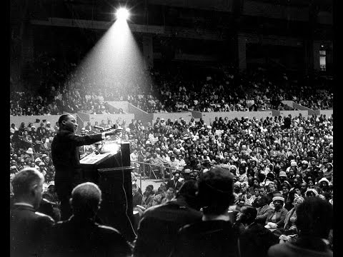

Persuasive techniques
Listen to some of the most persuasive
speeches for inspiration.
Notes:
‹#›
‹#›

Slide 5

Persuasive techniques
When you set out to persuade someone, you want them to accept your opinion on an issue: you want to change that person's mind to your way of thinking.
This means that you need to be very aware of your audience; you want to be forging a link with them by establishing a common goal.
Notes:
‹#›

Slide 6

Persuasive techniques
There are three areas we should attempt to appeal to when trying to get our audience on side:
APPEAL TO REASON
Most people believe themselves to be reasonable, so appealing to a person's sense of reason is the most effective means of convincing them to change their way of thinking ('If we don't do this... then... ).
APPEAL TO CHARACTER
We all share certain common ideas of what is just and fair! Appealing your audience’s sense of what is right and fair can be a powerful persuasive device, e.g. 'Like you, I share a sense of horror and repulsion at what is happening...'.
APPEAL TO EMOTIONS
Persuasion often succeeds by the careful and considered use of emotion - especially showing how passionate you feel for your point of view.
Notes:
‹#›

Slide 7


Appeal to reason
Recognise that your audience feel they hold a reasonable view already, but try to dissuade that view by showing how much more reasonable your own position is.
Provide evidence to support your ideas to suggest that they are reasonable and logical.
However…
Because you are being persuasive, and not writing to argue,
you do not have to provide
entirely ‘neutral’ facts.
Notes:
‹#›

Slide 8

Appeal to reason
Every year, hundreds of thousands of calves like this one are separated from their mothers within days of birth.
This is a fact – it can be tested.
However, it is also still very emotive, why?
Notes:
‹#›

Slide 9

Appeal to reason
So an effective way of appealing to your audience’s sense of reason, while still presenting your view as the only correct view, is to use emotive facts rather than objective ones.
You work for The Vegetarian Society, you are trying to persuade people that turkey farming is cruel. See if you can improve the following facts by making them more emotive.
Approximately 10 million turkeys are killed in November/December. In the wild turkeys could live up to 10 years; farmed turkeys are usually killed between the ages of 12 and 26 weeks.
Notes:
‹#›

Slide 10

Appeal to character
You need to try to convince your audience that you and they are very similar, sharing parallel ideas and views.
One way to do this is to create a sense of a shared personal or cultural experience.
Notes:
‹#›

Slide 11

Appeal to character
Be respectful... use an appropriate tone to suit your audience and purpose.
Be generous... people often put their own interests first. What can you offer your readers to help them change their mind?
Be modest... no one will listen to an arrogant, impolite big-head.
writing
Notes:
‹#›

Slide 12

Appeal to character
Be personal... persuasion works best when you know your audience well so consider your reader, think about what their current views are and what has brought them to think that way - think about addressing them as a 'friend using the pronoun 'You'.
Be concerned... and show that you share your
reader's concerns even if your view is different.
Notes:
‹#›

Slide 13

Appeal to emotions
The most important persuasive technique is to sound authentic and passionate (as if you really mean what you say!) and this requires a confident tone: sound like you are sincere and believable.
What tends to happen to our vocabulary
choices when we talk about something we are passionate about?
Notes:
‹#›

Slide 14

Appeal to emotions
Some words have connotations that evoke an emotional response.
Consider the difference
between the words
building, house
and home.
Notes:
‹#›

Slide 15

Making your point
The distinction between writing to persuade and writing to argue is incredibly subtle.
In both cases you need to present a supported
written argument.
What is the difference when writing to persuade?
writing
Notes:
‹#›

Slide 16
In any form of argumentative writing you need to make sure that your points are clearly stated and well-developed.
I think that animals
should have the
same rights as
human beings.
The point is clearly stated, but it lacks details. Without these details the writer will fail to convince their audience.
Notes:
‹#›

Slide 17

How do you make an effective point?
* Introduce it.
* Explain it.
* Justify it.
* Drive it home.
Notes:
‹#›

Slide 18


Drive your point home
End on a question to make the reader think.
Think for a moment. Wouldn’t you be happier
if everything in life
was this simple?
Notes:
‹#›

Slide 19

More resources at Cool Australia
For more cool resources head to www.coolaustralia.org to explore over 1,200 free-to-access, Australian curriculum and EYLF aligned activities, lessons and resources for teachers.
Student can explore videos, news articles, pictures and factsheets in the digital library - www.coolaustralia.org/student-toolbox/

