Slide 1
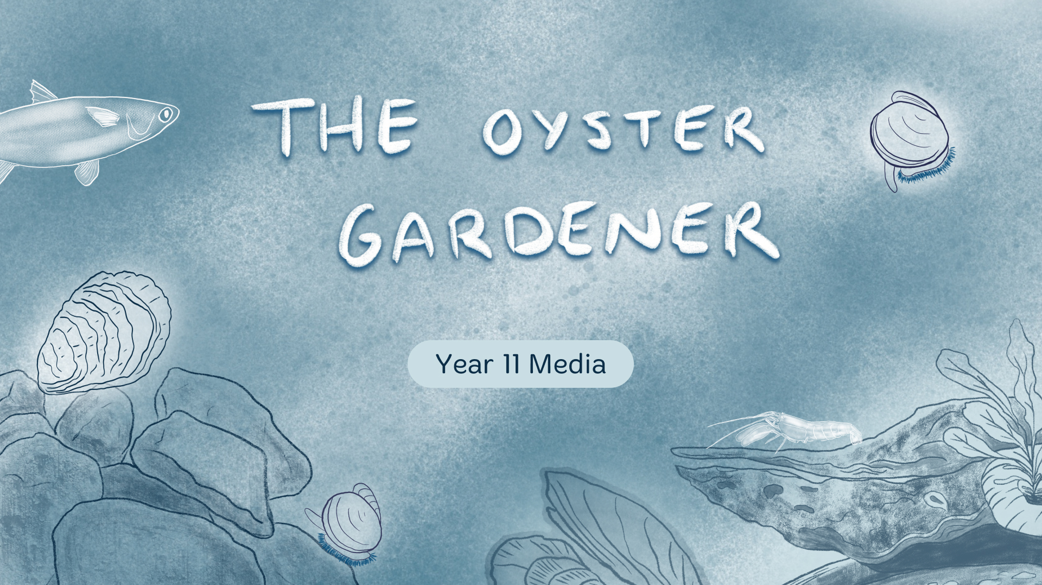

Slide 2

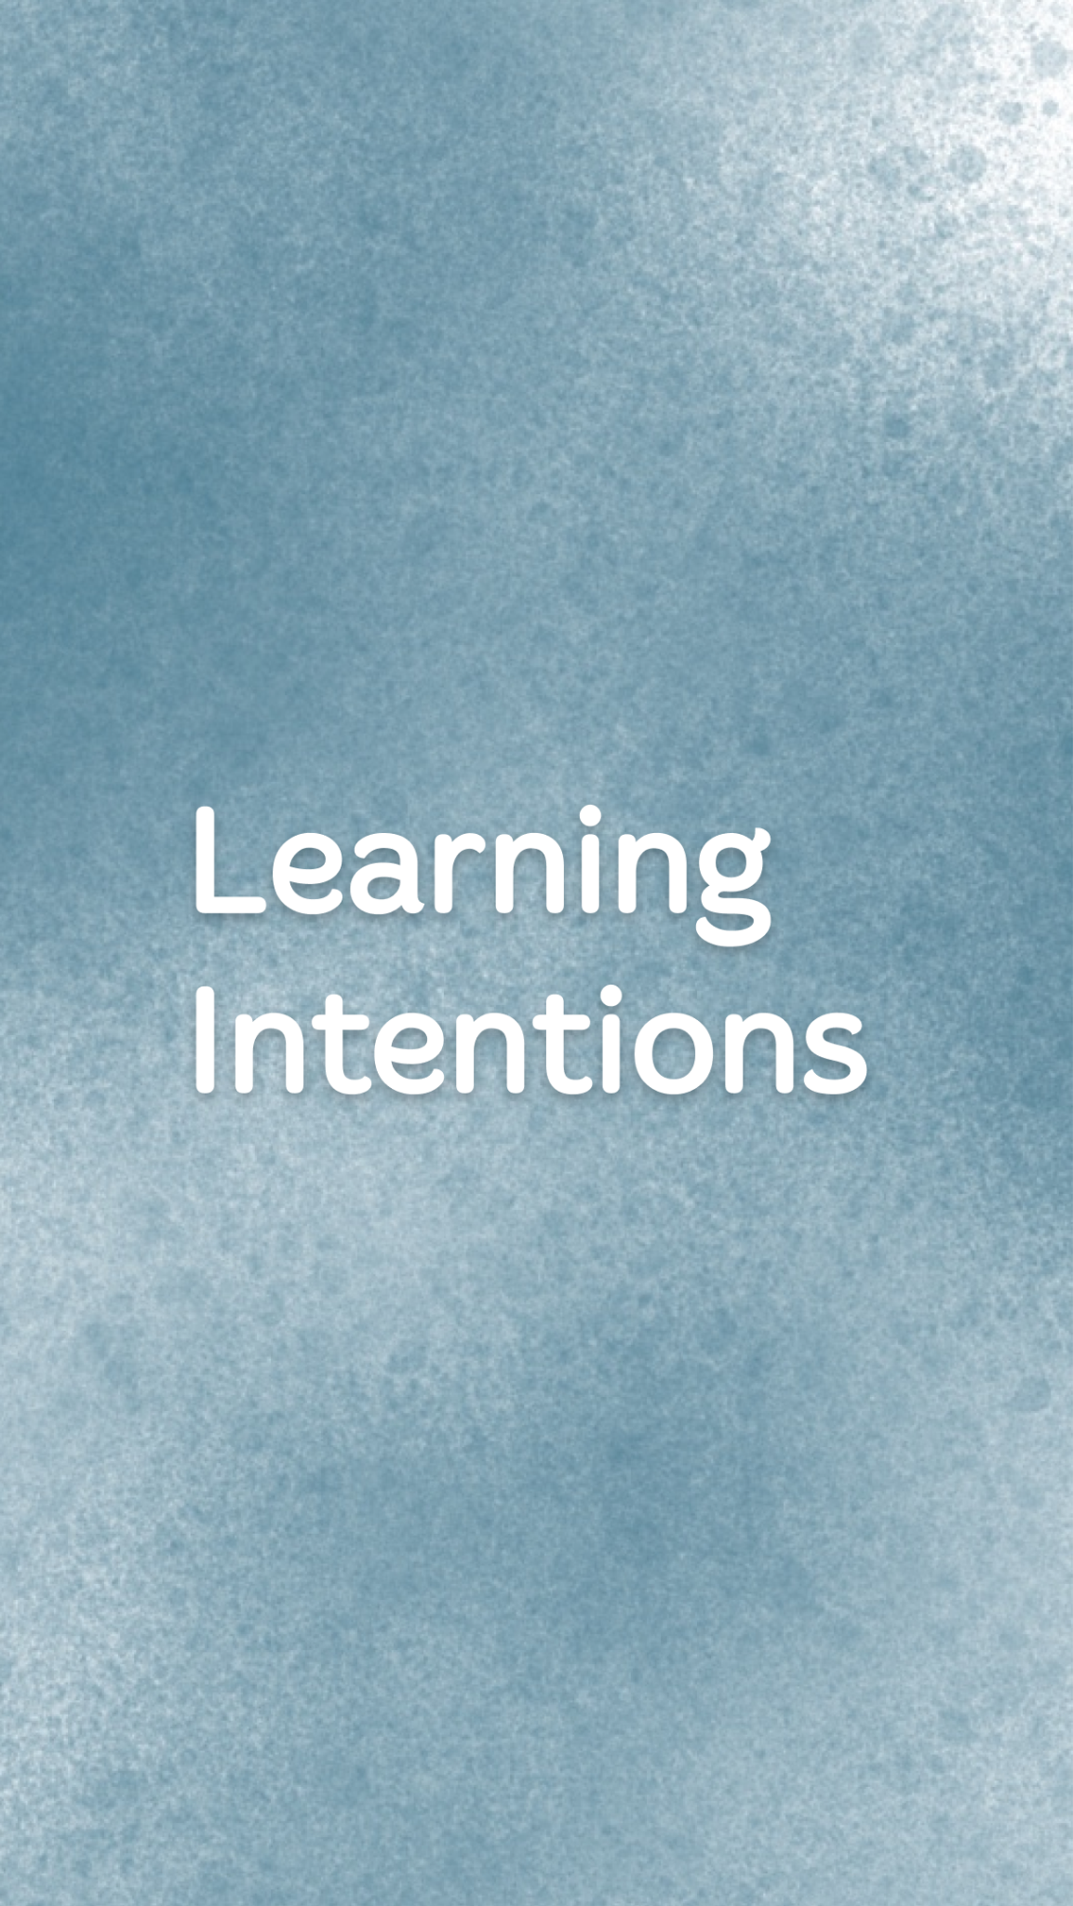
To understand how sustainability impacts
all areas of filmmaking.
To understand documentary conventions.
To understand how technical and symbolic codes are used to convey meaning.
To think about how sustainability will affect your future productions.

Slide 3


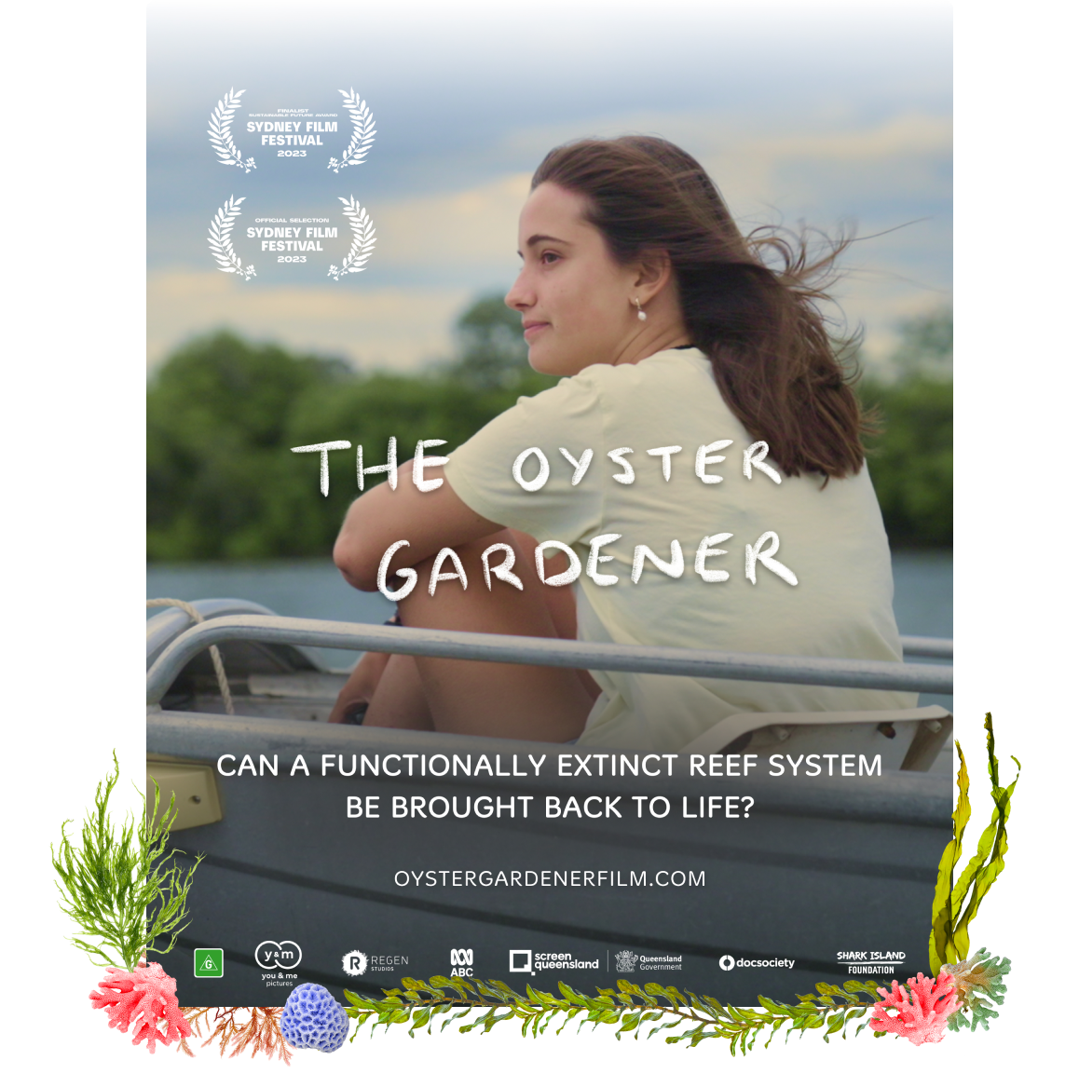
What can you infer about the film from the poster?
What does the setting tell you?
What does the font imply?
What does the text tell you?
What themes might be present?

Slide 4

In media, when we are talking about institutions, we are talking about the companies who are involved in the various stages of production.
Visit The Oyster Gardener website and read through the information on the page.
Who produced the film?
Who provided funding for the film? List all the sources.
Have you heard of any of these organisations before? Which ones?

Slide 5
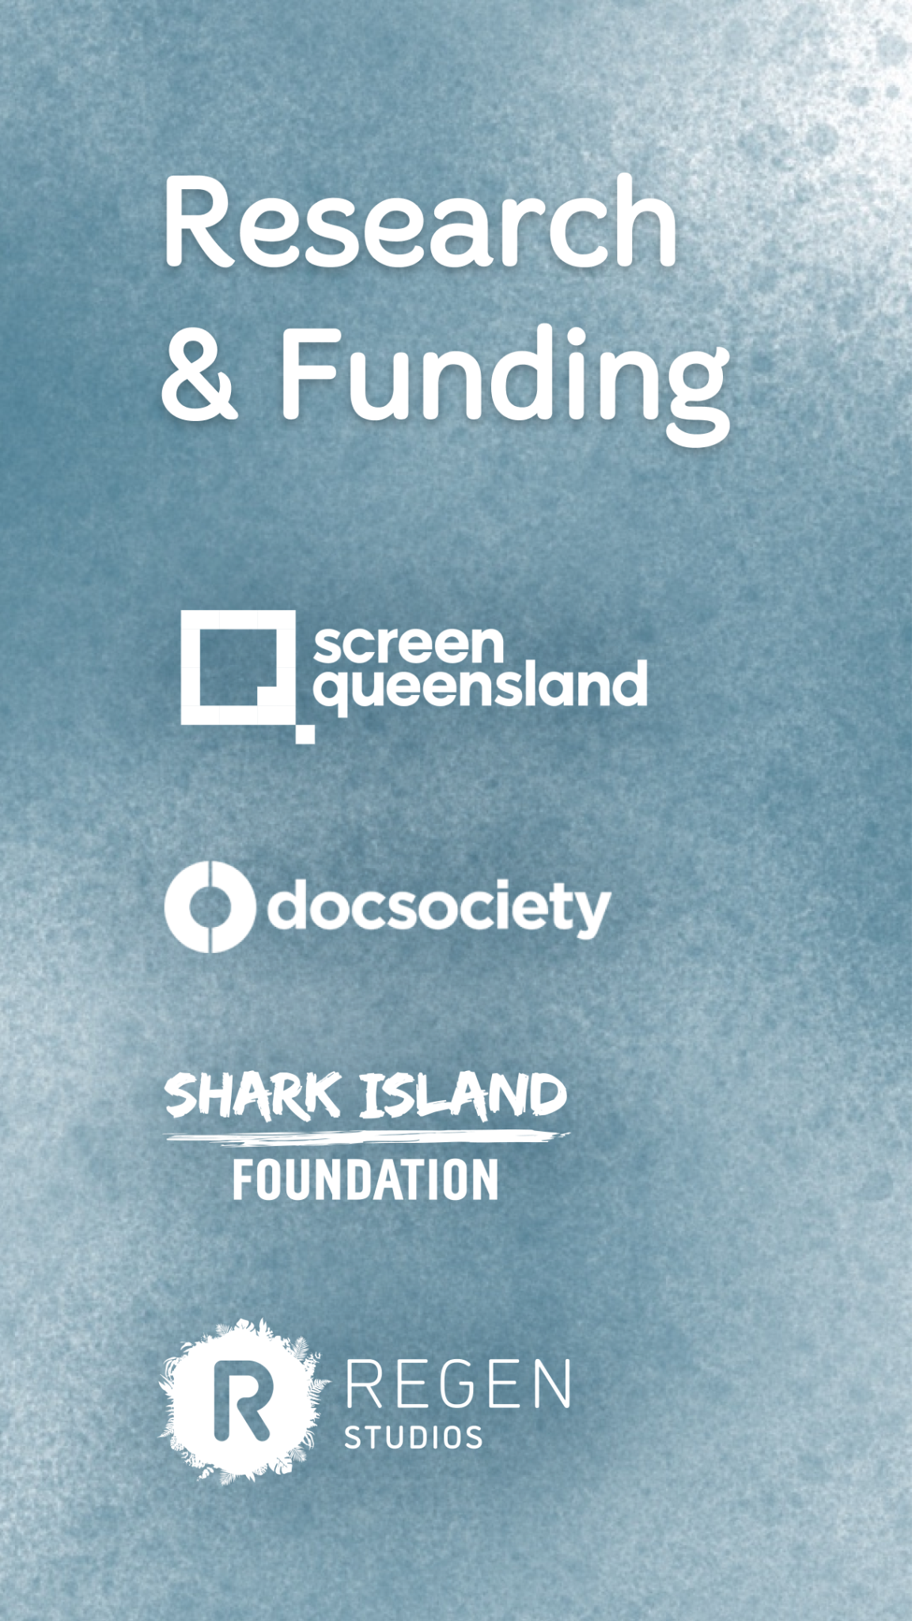
Choose either Screen Queensland, Doc Society, Shark Island Foundation or Regen Studios, and follow the link to their website.
Read about what they do and what they’ve supported. Write a short summary into your notes.
How do these institutions support the Australian film industry?

Slide 6

The Oyster Gardener lived its ethos of sustainability.
At all stages of production, sustainability was at the forefront for the creators.
Using a carbon calculator (Sustainable Screens Australia and BAFTA albert), producers Julia Lörsch & Kim Ingles were able to input all of their data and figure out what the carbon footprint of the film would be.
By doing so, they were able to look at all the areas in which they could reduce their environmental impact.

Slide 7

The film was produced by You and Me Pictures in association with Regen Studios.
The Oyster Gardener was predominantly funded by Screen Queensland for approximately $18,000. Regen Studios also supported the film with funding from Shark Island Institute.
ABC and Doc Society worked together to provide several production teams with a distribution channel, funding and mentoring, for a number of short Australian documentaries - the ‘Your Planet’ program - that profiled stories about environmental and climate solutions.
Find out more about the ‘Your Planet’ documentary initiative.
Pre-production for The Oyster Gardener began on August 25th, 2022 and production commenced from November 7th 2022.

Slide 8

The Oyster Gardener was shot in Queensland in Dec 2022 and Jan 2023.
A key feature of the film was sustainability, and the producers went into a lot of detail to ensure they remained as remained as low carbon/ low emission as possible. This included looking at what would be highest usage of emissions for productions - which was cars for both talent and crew, boat hire and fuel, followed by electricity.
During production, these were some of the practices they put in place that helped them keep the production’s footprint low:
  By planning and distributing the film digitally including having remote meetings with EPs / partners (ABC and Regen Studios) to minimise travel
  Vegetarian catering on set
  Cast and crew brought their own refillable drink bottles to set
  Carpooling with cast and crew to get to set
  Ensuring all batteries used are rechargeable
  Eating at cafes meant no waste and take away packaging.

Slide 9

As with the rest of production, post was no exception to the sustainability ethos and this was accounted for in the calculator.
Colour grading and sound mixing was done remotely, working with providers in other parts of the country who were able to facilitate a remove reviewing process meant
that no travel was required.
An additional, pick-up shoot in Tasmania was arrange for a local filmmaker, which meant that crew from the Sunshine Coast didn’t have to travel. A bonus is that Tasmanian power has less GWP (mostly hydro).
A large portion of the footprint for post production was the energy use from edit suits.

Slide 10

The Oyster Gardener premiered at the Sydney Film Festival (SFF) on June 8th 2023, and was shortlisted for the SFF’s Sustainable Future Award.
It became available to stream on ABC iView from Saturday 17 June, 2023.
It was broadcast on ABC after Landline on Saturday 29 July at 4:20pm.
The film is available on ClickView for Australian schools to access.

Slide 11

A documentary film is a film which concerns factual topics and information about the real world.
‘Documentary conventions’ are elements that you expect to see when you watch a documentary.
Think about documentaries you have seen – what elements did you see across them all? This can include mockumentaries, which also use these elements but for comedic purposes.

Slide 12

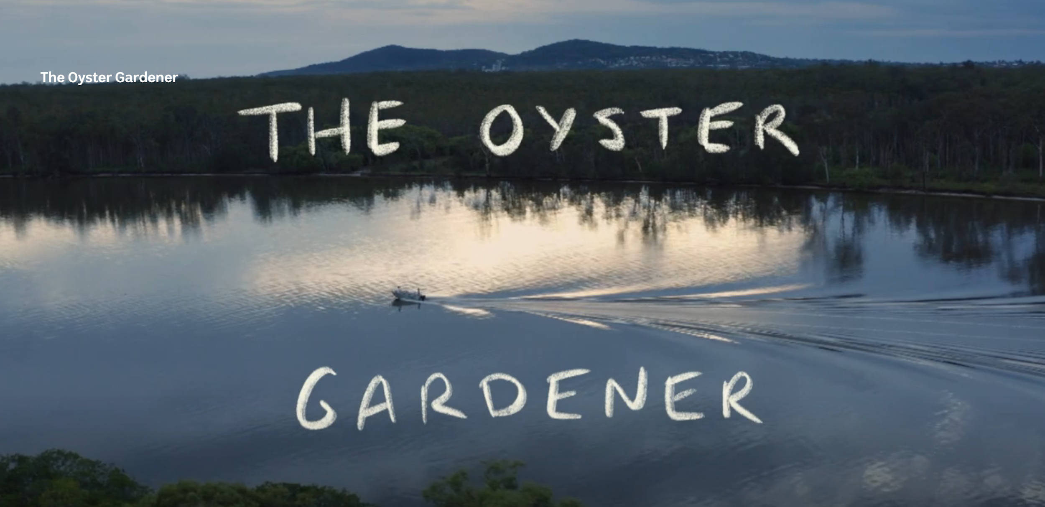
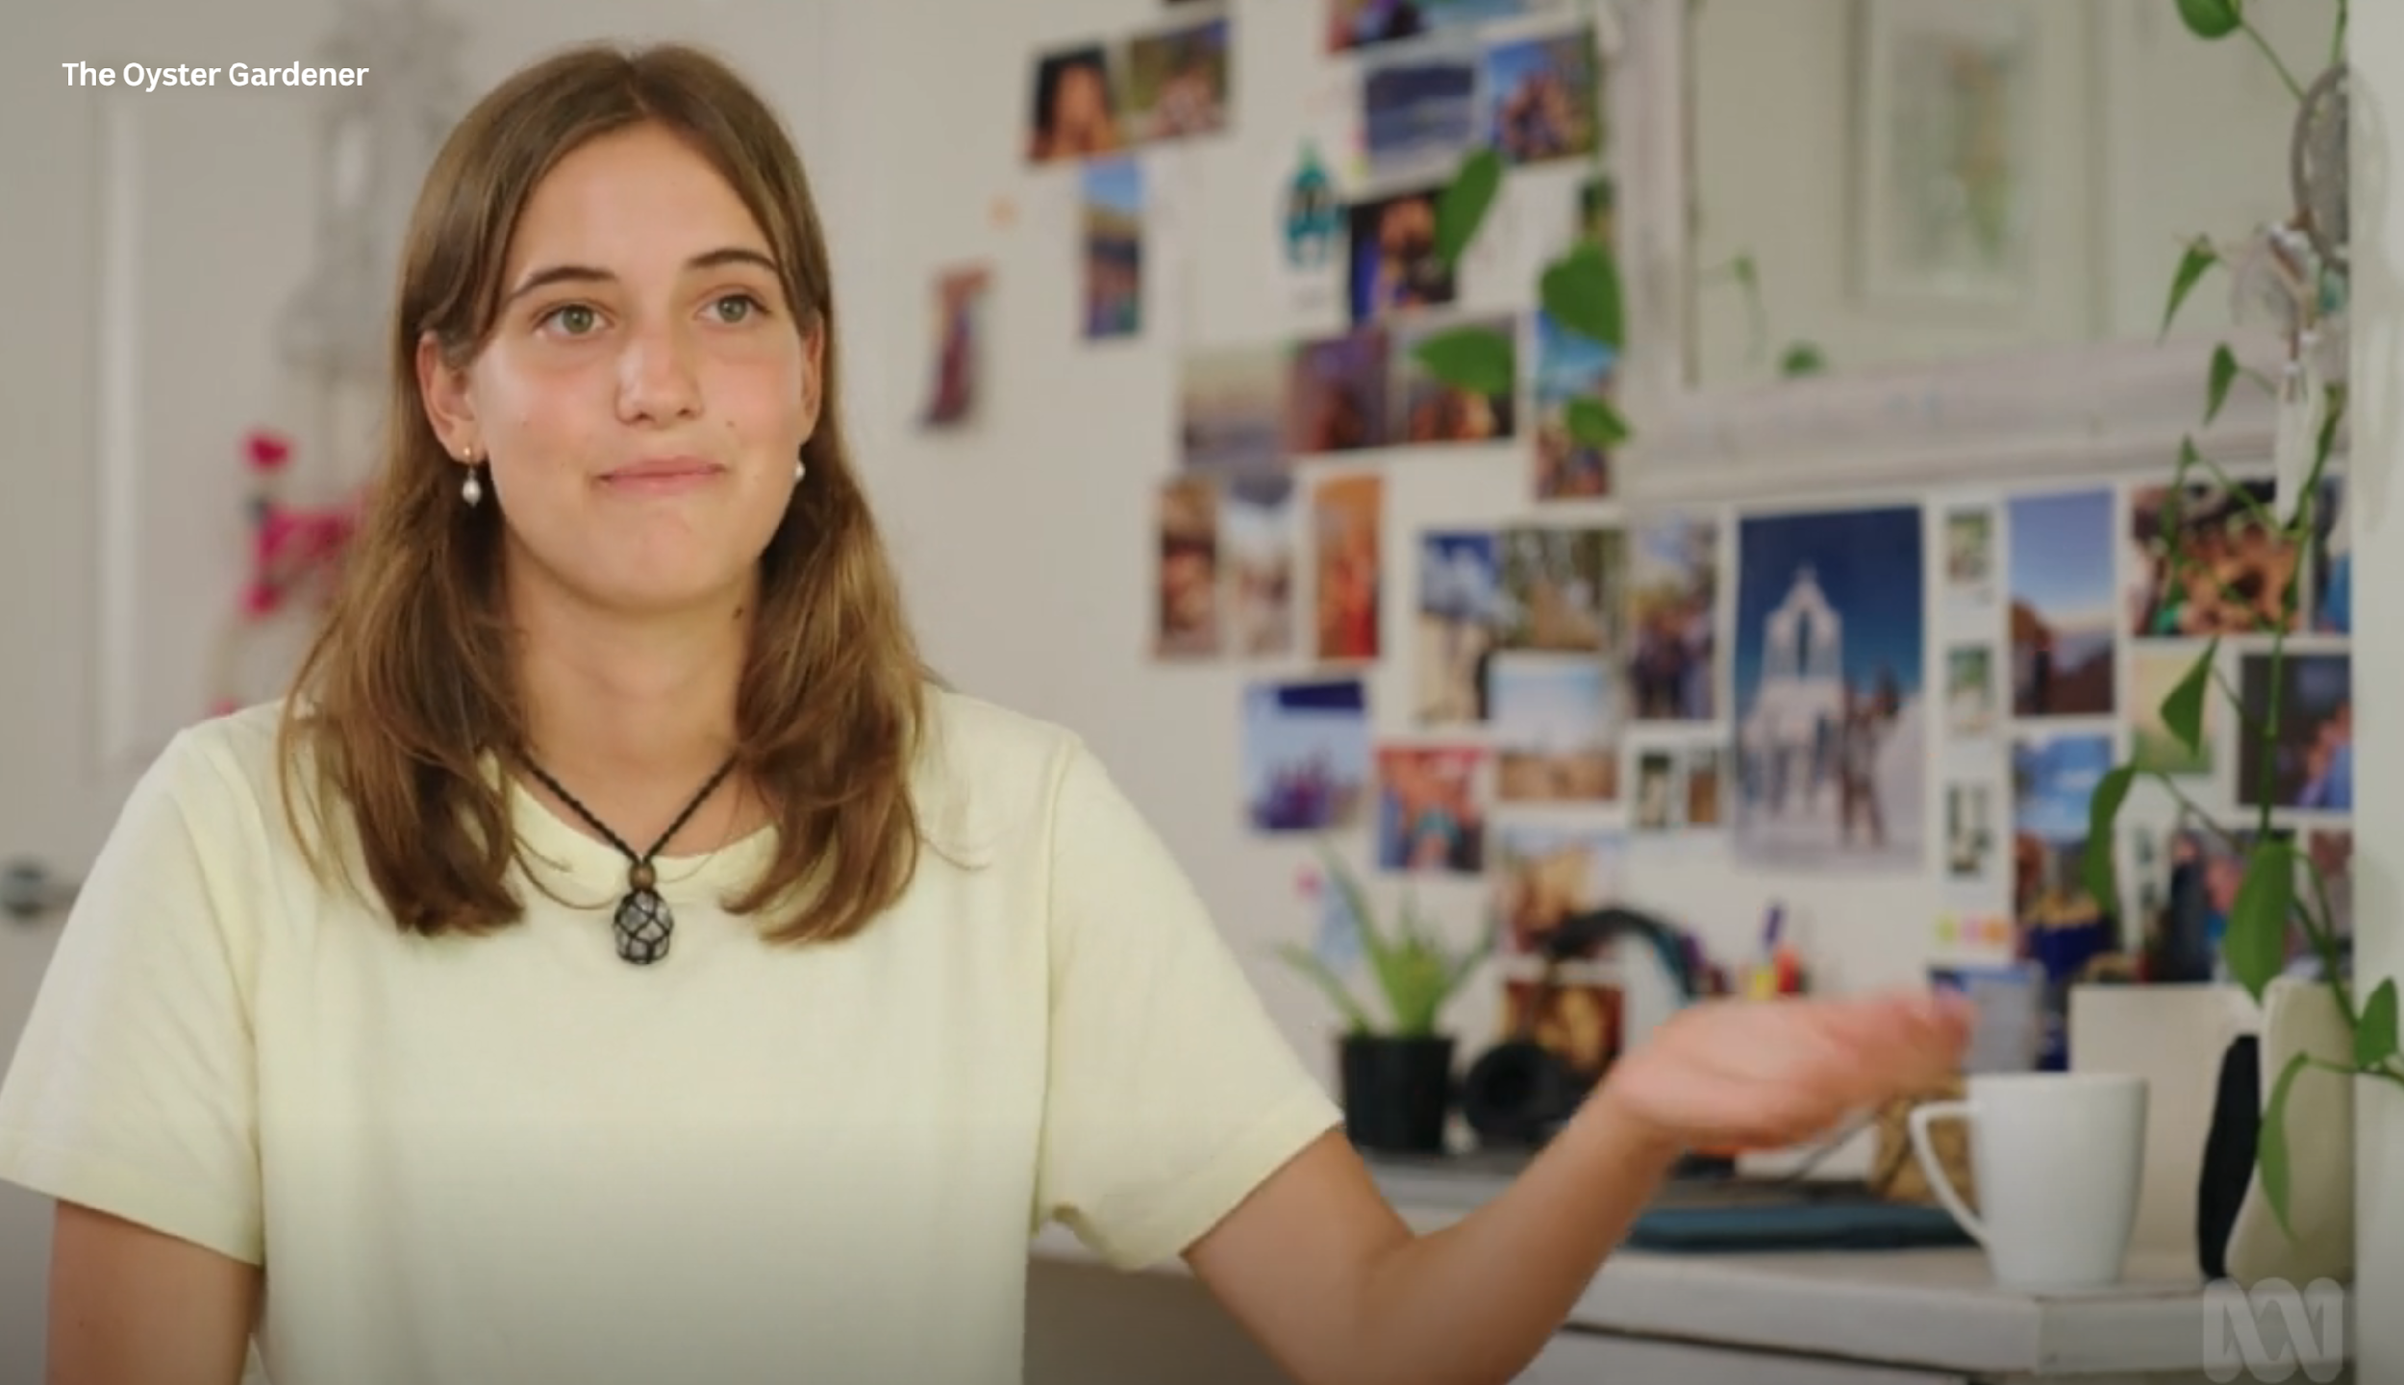
Some examples of documentary conventions
include:
Use of voice-overs
Interviews (direct and indirect)
Subtle editing
Archival footage and photographs
Use of real people
Exposition
Use of text and titles
Montage

Slide 13

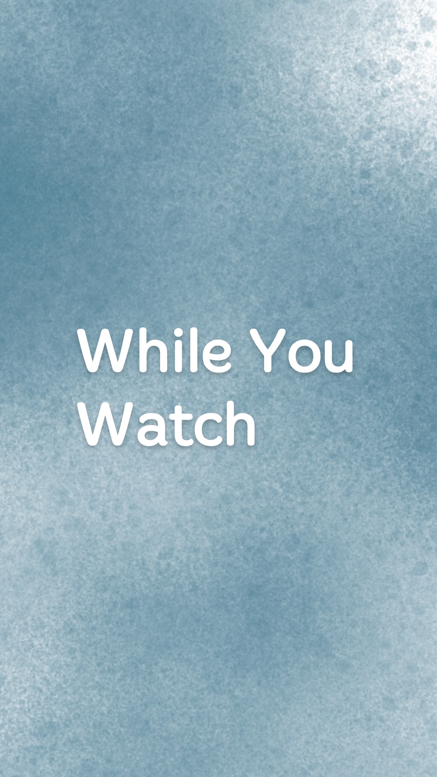
Who is the protagonist in this narrative?
What are the main themes being conveyed?
Provide 3 examples of documentary conventions which were used in the film.
At the end, summarise what Jolie wanted to do and what she accomplished.

Slide 14

What narrative structure does this film follow? Plot out the key points against this structure.
Discuss how the use of camera angles, shot types and movement help to engage audiences in the film.
What kinds of graphics were used? What impact do you think this had?
Describe the use of diegetic and non-diegetic sound. What emotions does this help convey to audiences?
Describe the mise en scene used in the film and other details such as time of day, the places filmed in etc. What does this tell audiences about the characters and the story?

Slide 15

The social context of a film influences how we interpret and understand it. Issues such as environmentalism are quite large and dominant topics of public discourse, particularly over the last 10 years.
How would prior knowledge affect the way someone understands this film?
Using Hall’s theory of dominant, negotiated, and oppositional readings, identify which specific audiences would fit into each of those categories. Which audience groups would have agreed with the filmmakers and had a dominant reading? Why? Then, negotiated and oppositional.
How are audiences able to consume this film? How might that impact their engagement?

Slide 16

With a major rise in the discussion of environmentalism in the last 10 years, there has also been a rise in eco-anxiety.
A global survey found that 70% of young people feel hopeless in the face of the climate crisis.
More research is also coming out to support how important collective action is to transform feelings of distress and anxiety around the climate crisis.
Go to https://www.forceofnature.xyz/ Read about how the organisation began and what do they do. Write this into your notes.
Watch Clover Hogan’s TED Talk and using the ideas/questions she posits, create a poster with some ways that young people can take action. Alternatively, create a poster featuring stories of young people who are making change in their communities and share what they have achieved.

Slide 17

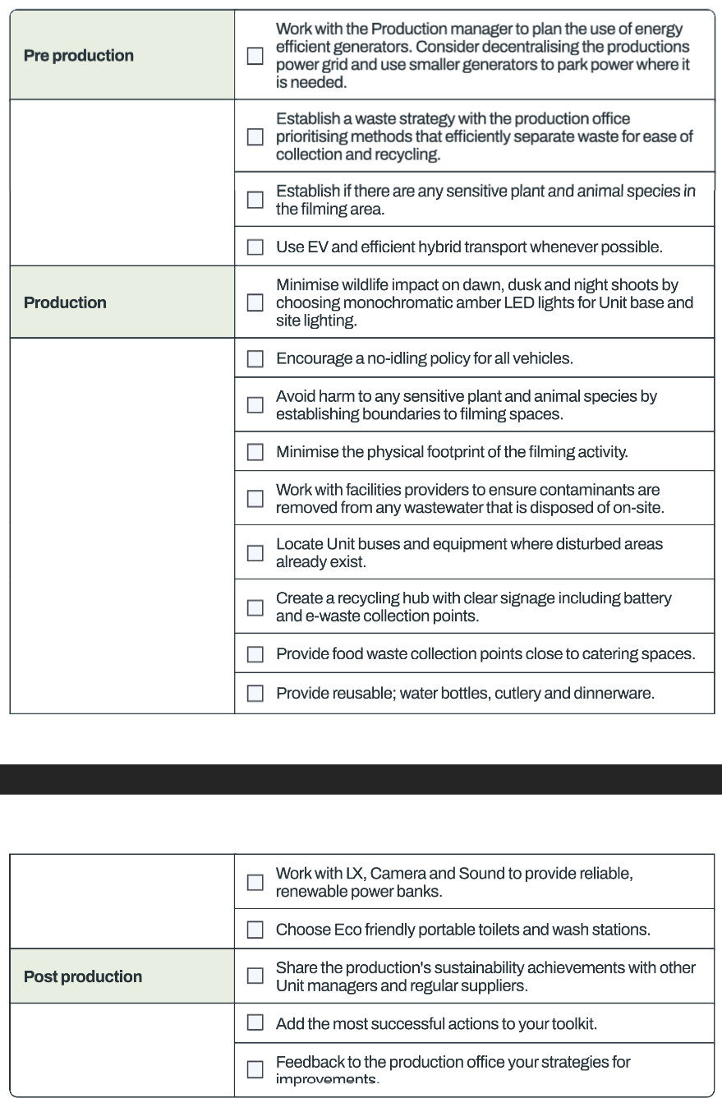
Go to Sustainable Screens Australia and have a look around the website.
What services do they provide? What did you learn?
Have a read of some of the checklists (found here). What were some elements you hadn’t thought about before?
How might this affect the planning of your production next semester?

Slide 18

What is a social impact campaign?
Documentaries have a unique power to inspire change.
An impact campaign takes a documentary and creates a strategy from it, defining what kind of impact the documentary can achieve and seeking measurable results. It is about thinking about your film as a tool for social change and putting a plan in place for how you will reach the right audiences, who you can partner with and how you distribute the film, how you can create more engagement with the film and what you will ask your audience to do after seeing the film.
It’s about using the power of storytelling to its maximum potential.
What does an Impact Producer do?
An impact producer is responsible for designing and implementing strategic impact and education strategies around social impact documentaries. Larger projects may have a whole impact team on them.

Slide 19

Impact Vision Statement: Young people are empowered to connect with their local environment and transform climate anxiety into grounded, active hope by learning about and contributing to caring for their local waterways.
Impact goals:
Inspire young people to find their agency and motivation to create change in their own communities through local ecosystem restoration efforts
Help alleviate climate anxiety by showcasing solutions and providing pathways for young people to take meaningful action in their own community
Enable and empower teachers and educators to host screenings of the film and utilise the educational materials to support classroom learning, and facilitate conversations with young people, about solutions to the climate crisis and biodiversity loss, and the value of getting involved in local, collective action (and the power of storytelling)
Motivate more environmental organisations to create citizen science programs that engage young people as citizen scientists, volunteers, traineeships and work placements.

Slide 20

Your turn! Pretend you are an Impact Producer for the The Oyster Gardener.
Choose 2 of the impact goals from the previous slide and brainstorm all the ways that you could achieve impact with the film to reach those goals. Include ideas for organisations you could partner with, resources you could create, and special opportunities to enable your target audience to see and engage with the film.
For example, if you chose number 4, you could come up with some ideas to host screenings for various environmental organisations and NGOs. Are there any special International or National days (ie. World Ocean Day) or conferences/summits you can find, that you could tie a screening to? Are there any events or groups locally that you would approach and connect with for a screening and also to discover how you could get involved with volunteering ongoing yourself.
Tip: Check out the Impact Field Guide and Toolkit to find case studies and examples of how other impact films have reach and inspired their audience: https://impactguide.org/library/
Notes:
Extension Task

